Slide 1

Mapping the Unknown: An Interactive UFO Experience
Chase Arnett, Zach Horn, and Jeff Gary

Slide 2

Our Dataset
The dataset originally consisted of approximately 70,000 unique records but was reduced to 10,000 records for efficiency and analysis purposes. Below is an explanation of the dataset structure and the methodology used for reducing its size:
Random Sampling:
Preservation of Key Patterns
Stratification
Removal of Duplicates
Retention of Extreme Cases
Balance Between Quantitative and Qualitative Data
Value of the Reduced Dataset:
The smaller dataset of 10,000 records retains the diversity and richness of the original while being computationally manageable. It provides a solid foundation for analysis, including:
Geographic trends (e.g., which states or cities report the most sightings).
Temporal trends (e.g., year-over-year changes in sightings).
Phenomenological analysis (e.g., which UFO shapes are most commonly reported).
Qualitative analysis of witness descriptions.
This approach strikes a balance between maintaining reliability and achieving efficiency in data processing and analysis.

Slide 3
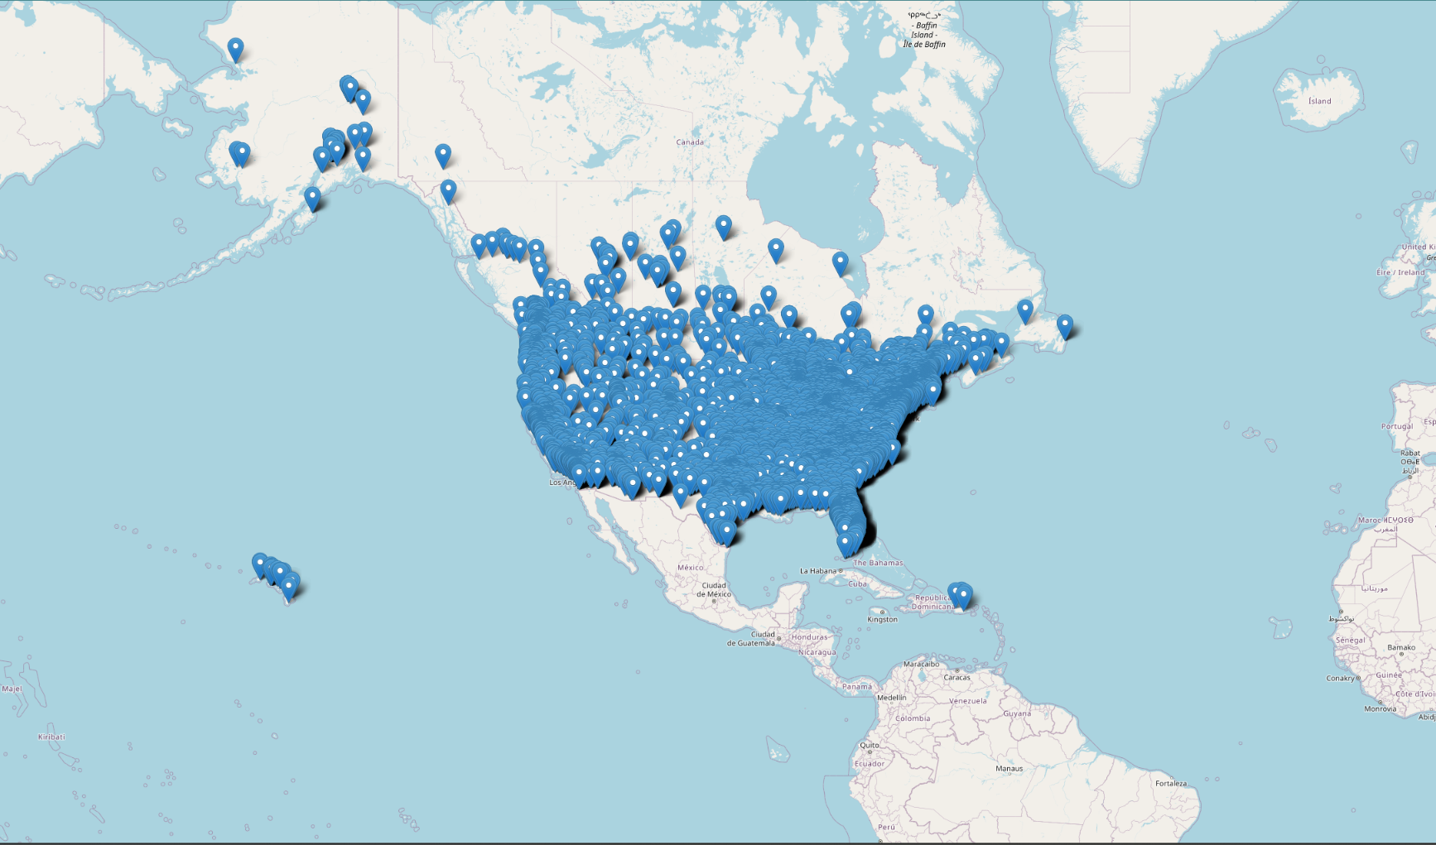
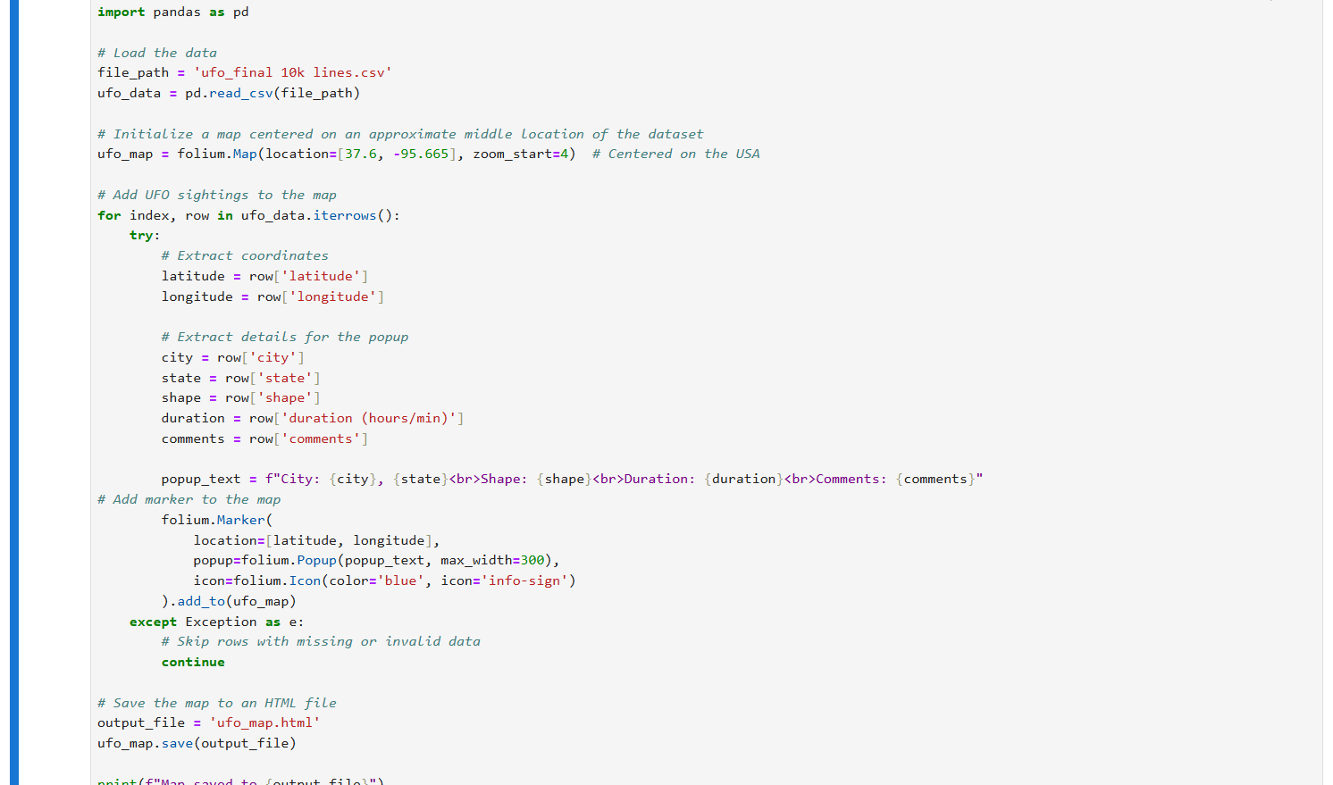
Interactive Map of USA sightings
Sightings are spread across the entire country, with notable clusters in certain areas. This suggests that there may be regional factors influencing the frequency of sightings.
UFO sightings are not limited to densely populated areas; there are reports from remote regions such as Alaska and Hawaii, but also suggests that sightings can occur in diverse environments, as well.
Certain states or regions may have a higher density of sightings. Exploring these areas, we can further provide insights into why these locations have more reports.
The high number of sightings could indicate a strong public interest in UFO phenomena and a willingness to report unusual occurrences.

Slide 4
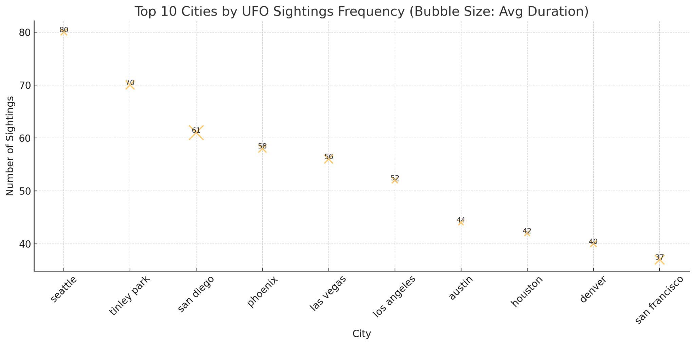
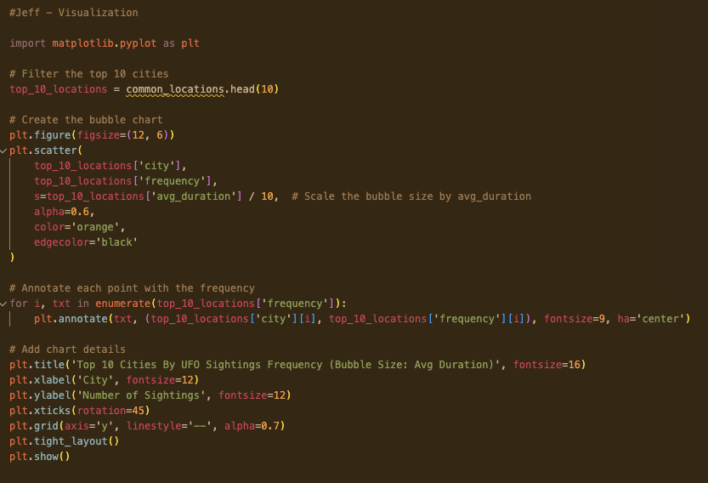
What are the common location sightings, and how does their frequency/duration differ from one place to another?
Insights
High Urban Sightings: Most of these cities are urban hubs, which suggests that areas with higher populations tend to report more sightings. This could be due to more people looking at the sky or a higher likelihood of anomalous events being witnessed.
Variation in Duration: While San Diego has fewer sightings than Seattle or Tinley Park, the average duration of its sightings is far higher (~3,161 seconds, or ~52 minutes). This could indicate more persistent or observable phenomena in this region, possibly due to environmental factors or localized phenomena.
Tourism and Lights: Cities like Las Vegas and Phoenix, known for their vibrant nightlife and clear skies, may naturally lead to more observations of unexplained lights, even if they are not UFOs.
*These differences suggest that not all UFO reports are the same—some areas may report more brief anomalies, while others see longer-lasting or more remarkable events.*
The top five cities for UFO sightings in the USA are:
Seattle, WA: 80 sightings (Average duration: ~626 seconds)
Tinley Park, IL: 70 sightings (Average duration: ~1,169 seconds)
San Diego, CA: 61 sightings (Average duration: ~3,161 seconds)
Phoenix, AZ: 58 sightings (Average duration: ~983 seconds)
Las Vegas, NV: 56 sightings (Average duration: ~1,136 seconds)

Slide 5
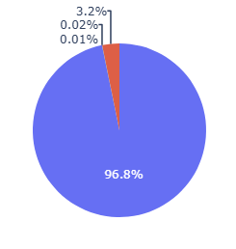
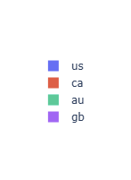
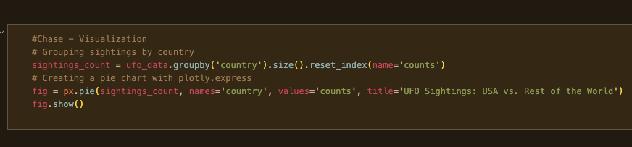
What is the frequency of UFO sightings in the USA compared to the rest of the world?
The USA reports the vast majority of UFO sightings in the dataset, with 9,676 sightings, compared to 320 sightings in Canada, 2 in Australia, and 1 in Great Britain. This disparity can be attributed to several factors:
Population Size: The USA has a significantly larger population than Canada, Australia, or Great Britain, leading to more reported sightings.
Cultural Influence: The USA has a long history of fascination with UFOs, bolstered by media coverage, folklore, and institutions like Area 51. This cultural phenomenon likely increases the likelihood of sightings being reported.
Awareness and Accessibility: Organizations like MUFON (Mutual UFO Network) in the USA encourage the public to report UFO sightings, which may not be as prevalent in other countries.
In contrast, countries with fewer sightings may not prioritize UFO reporting or lack centralized systems to document these events. This discrepancy suggests that cultural, institutional, and awareness factors significantly influence UFO reporting trends.

Slide 6
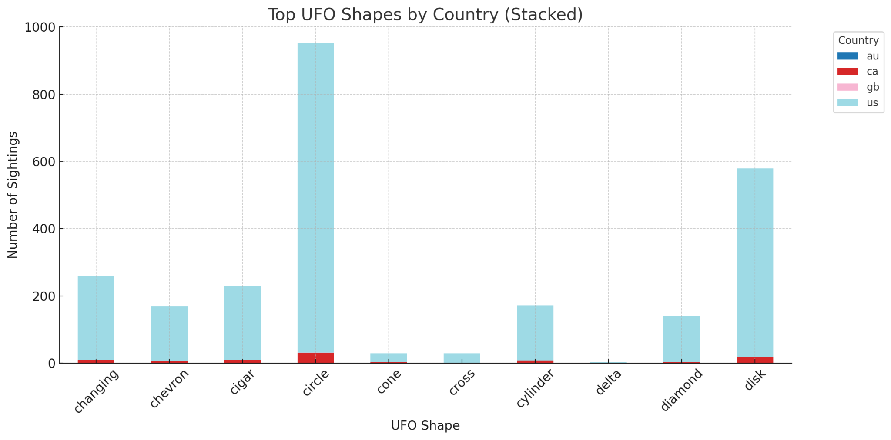
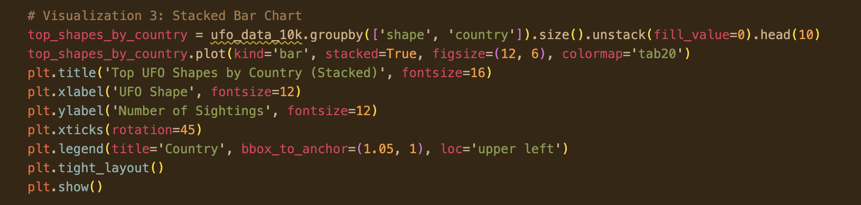
What are the most common shapes of UFOs, varying by location?
Insights
Dominance of "Light" and "Triangle": The high frequency of "Light" sightings suggests that many UFOs are seen as simple points of light, possibly influenced by stars, satellites, or aircraft. On the other hand, "Triangle" sightings are less likely to be mistaken for natural phenomena and could represent structured objects.
Geographic Distribution:
"Triangle" sightings are commonly reported in urban and suburban areas, potentially aligning with military testing zones (e.g., stealth aircraft with triangular designs).
"Fireball" sightings may correlate with meteor activity, given their fiery appearance and sudden disappearance.
"Unknown" Classification: The significant number of "Unknown" shapes highlights the difficulty of identifying certain phenomena. This category could include ambiguous observations that defy conventional explanations.
The most frequently reported UFO shapes in the USA are:
Light: 1,923 sightings
Triangle: 1,004 sightings
Circle: 923 sightings
Unknown: 880 sightings
Fireball: 805 sightings

Slide 7
Broader Implications:
These analyses highlight the complexity of UFO sightings and their dependence on cultural, geographic, and technological factors. The differences in frequency, location, and shape illustrate how UFO reporting is influenced not just by the phenomena themselves but also by societal factors like awareness, perception, and reporting mechanisms. For a deeper exploration, future analyses could focus on the following:
Temporal Trends
Seasonality
Correlation with Events
How have UFO sightings changed over time?
Are sightings more common during specific times of the year?
Do sightings increase during meteor showers, satellite launches, or other celestial events?

